Slide 1


Priyadarshini Engineering College
Department of Master of Computer Applications
Name : Nesaraj.T
Reg. No: 511922622035
MC4411 PROJECT WORK
Online Voting System
Web Application in Python
SUPERVISOR
Dr.Manikandan G, M.Sc.,B.Ed.,M.Phil.,Ph.D., Head of the Department,
Department of Master of Computer Applications,
Priyadarshini Engineering College.
Vaniyambadi.
HEAD OF THE DEPARTMENT
Dr.Manikandan G, M.Sc.,B.Ed.,M.Phil.,Ph.D.,
Head of the Department,
Department of Master of Computer Applications,
Priyadarshini Engineering College.
Vaniyambadi.
Anna University, Chennai

Slide 2
Contents
ABSTRACT
INTRODUCTION
PROBLEM DEFINITION
OBJECTIVE OF THE PROJECT
EXISTING SYSTEM
PROPOSED SYSTEM
HARDWARE REQUIREMENTS
SOFTWARE REQUIREMENTS
ARCHITECTURE DIAGRAM
DATAFLOW DIAGRAM
ER DIAGRAM
CLASS DIAGRAM
SEQUENCE DIAGRAM
UML DIAGRAM
ACTIVITY DIAGRAM
DATABASE DESCRIPTION
CONCLUSION
SCOPE FOR FUTURE ENHANCEMENT
SCREEN SHOTS
REFERENCES
Anna University, Chennai

Slide 3
ABSTRACT
Online Voting System Web Application in Python
The Online Voting System is a web-based application designed to streamline and modernize the voting process, making it more accessible, efficient, and secure. This system aims to eliminate geographical constraints, reduce the chances of fraud, and enhance the overall voting experience for both voters and administrators, the Online Voting System is a cutting-edge solution that addresses the challenges associated with traditional voting methods. By leveraging technology, it promotes a fair, transparent, and inclusive democratic process while maintaining the highest standards of security and integrity.
Anna University, Chennai

Slide 4
INTRODUCTION
Online Voting System Web Application in Python
The Online Voting System is a web-based application designed to streamline and modernize the voting process, making it more accessible, efficient, and secure. This system aims to eliminate geographical constraints, reduce the chances of fraud, and enhance the overall voting experience for both voters and administrators, the Online Voting System is a cutting-edge solution that addresses the challenges associated with traditional voting methods. By leveraging technology, it promotes a fair, transparent, and inclusive democratic process while maintaining the highest standards of security and integrity.
Anna University, Chennai

Slide 5
PROBLEM DEFINITION
Online Voting System Web Application in Python
The problem definition of an online voting system in a Python Django project typically involves designing a web application that allows users to securely vote for various options or candidates online. Here's a breakdown of the key components and features typically included in such a system:
1.User Authentication: Users should be able to register, log in, and log out securely. User authentication ensures that only registered users can participate in the voting process.
2.Voting Options: The system should present users with a list of options or candidates they can vote for. These options should be clearly displayed and easily accessible.
Anna University, Chennai

Slide 6
3. Vote Submission: Users should be able to cast their votes securely. Once a user submits their vote, it should be recorded and stored securely to ensure the integrity of the voting process.
4. Vote Counting: The system needs to accurately count the votes cast for each option or candidate. The counting process should be transparent and secure to prevent tampering or manipulation of results.
5.Result Presentation: After the voting period ends, the system should display the results to users in a clear and understandable format. This could include graphs, charts, or simple tabular representations of the vote counts.
6.Security and Integrity: Security is crucial in an online voting system to prevent unauthorized access, tampering, or manipulation of votes. Measures such as encryption, secure authentication, and regular security audits should be implemented to ensure the integrity of the system
Anna University, Chennai

Slide 7
7. Audit Trail: The system should maintain a detailed audit trail of all voting activities, including user logins, vote submissions, and any administrative actions taken. This helps ensure transparency and accountability in the voting process
8.Accessibility: The voting system should be accessible to all eligible users, including those with disabilities. It should comply with accessibility standards to ensure that users can navigate and interact with the system effectively.
By addressing these key components, you can develop a robust and secure online voting system using Python and Django.
Anna University, Chennai

Slide 8
OBJECTIVE OF THE PROJECT
Online Voting System Web Application in Python
Our project involves developing a sophisticated online voting system web application using Django, a high-level Python web framework. The primary objective is to create a secure, efficient, and user-friendly platform that enables voters to participate in elections conveniently from anywhere with internet access. The application will feature robust user authentication and authorization mechanisms to ensure the integrity of voter identities and access control. Voter registration will be streamlined, with validation processes to prevent duplicates and verify eligibility. Administrators will have comprehensive tools to manage election processes, including ballot creation and customization for different voting scenarios. The voting interface will be designed to be intuitive and responsive, supporting various devices and screen sizes.
Anna University, Chennai

Slide 9
EXISTING SYSTEM
Online Voting System Web Application in Python
Backend Technology: Typically built using Python with frameworks like Django or Flask.
Frontend Technology: HTML/CSS for user interfaces, often with JavaScript for dynamic interactions.
Database: Stores voter information, candidate details, and voting records. Commonly uses databases like PostgreSQL or MySQL.
Authentication: Username/password login for user identification.
Security Measures: Basic encryption for data transmission and stoagre.
Anna University, Chennai

Slide 10
PROPOSED SYSTEM
Online Voting System Web Application in Python
1. Enhanced Security:
- Implement advanced encryption algorithms for heightened security.
2. Decentralization with Blockchain:
- Utilize blockchain for decentralized storage of voting data, reducing the risk of central point vulnerabilities.
3. Accessibility Features:
- Design a user-friendly interface with considerations for accessibility (e.g., screen reader compatibility, high contrast options).
4. Multi-Factor Authentication (MFA):
- Integrate MFA to add an extra layer of user verification, ensuring secure access to the voting system.
5. Real-Time Monitoring:
- Provide real-time monitoring tools for election administrators to track voting progress and detect irregularities
Anna University, Chennai

Slide 11
6. Voter Verification Mechanism:
- Establish a secure and transparent method for voters to verify that their vote was cast as intended.
7. Testing and Auditing:
- Conduct thorough security testing and regular audits to identify and address potential vulnerabilities.
8. Digital Receipts:
- Offer voters the option to receive a digital receipt for their vote, enhancing transparency and confidence in the system.
9.User Education:
- Implement a comprehensive user education program to ensure voters are informed about the new features and security measures.
The proposed system aims to address security concerns, enhance accessibility, and leverage emerging technologies for a more robust and trustworthy online voting experience.
Anna University, Chennai

Slide 12
HARDWARE REQUIREMENTS
Online Voting System Web Application in Python
Processor : AMD PRO A4-4350B R4,
5 COMPUTER CORES 2C+3G
Memory : 4 GB RAM
Hard Drive : 500 GB
System Type : x64-based processor
Anna University, Chennai

Slide 13
SOFTWARE REQUIREMENTS
Online Voting System Web Application in Python
Operating System Edition : Windows 10 Pro Education, 64-bit os
Version : 22H2
Front End : HTML, CSS,
Back End : Python, Java Script
Server : SQLite
Anna University, Chennai

Slide 14
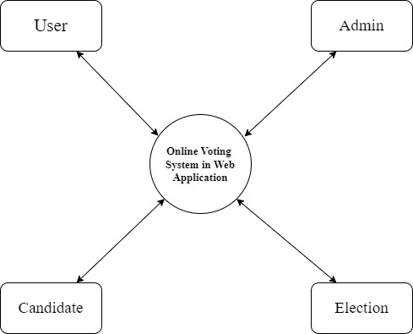
ARCHITECTURE DIAGRAM
Online Voting System Web Application in Python
Anna University, Chennai

Slide 15
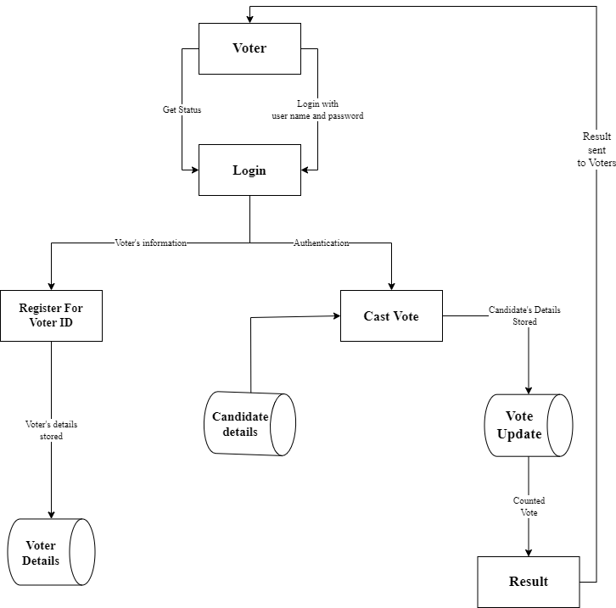
DATAFLOW DIAGRAM
Online Voting System Web Application in Python
Anna University, Chennai

Slide 16
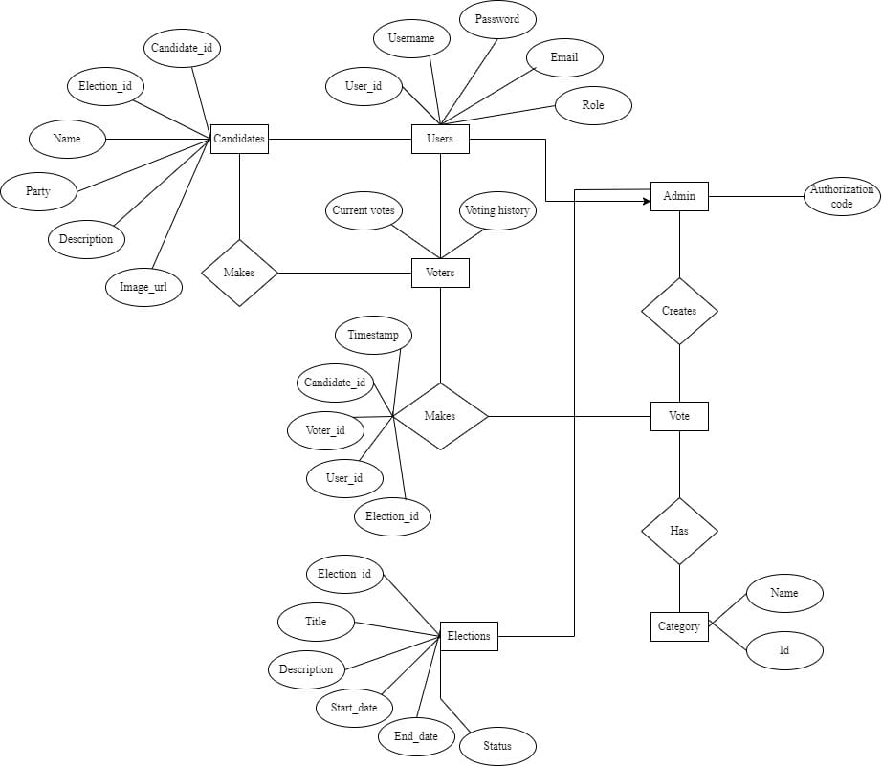
ER DIAGRAM
Online Voting System Web Application in Python
Anna University, Chennai

Slide 17
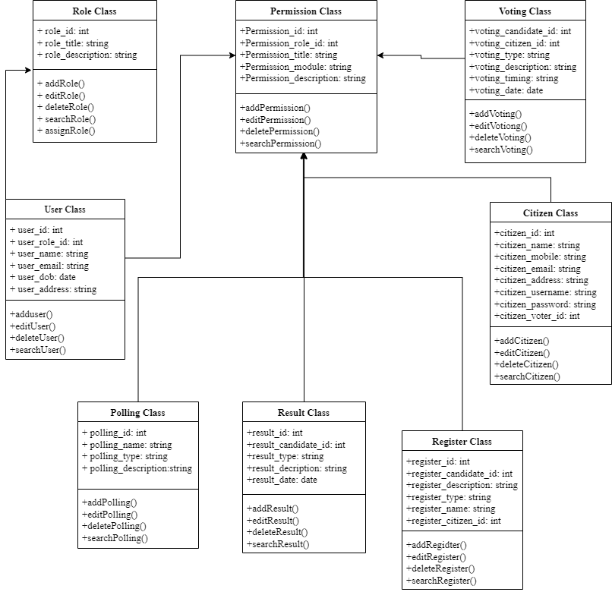
CLASS DIAGRAM
Online Voting System Web Application in Python
Anna University, Chennai

Slide 18
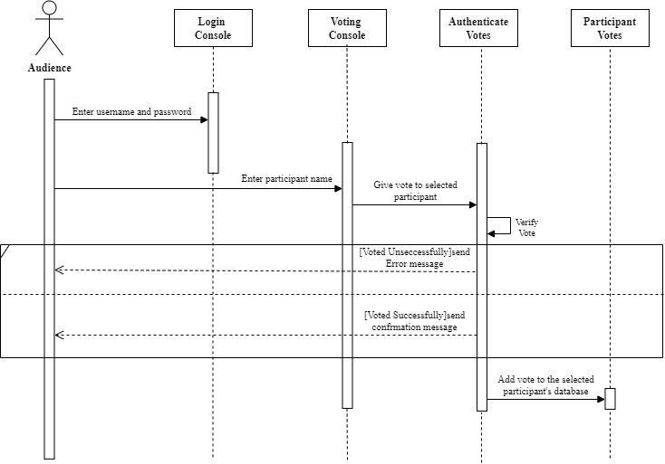
SEQUENCE DIAGRAM
Online Voting System Web Application in Python
Anna University, Chennai

Slide 19
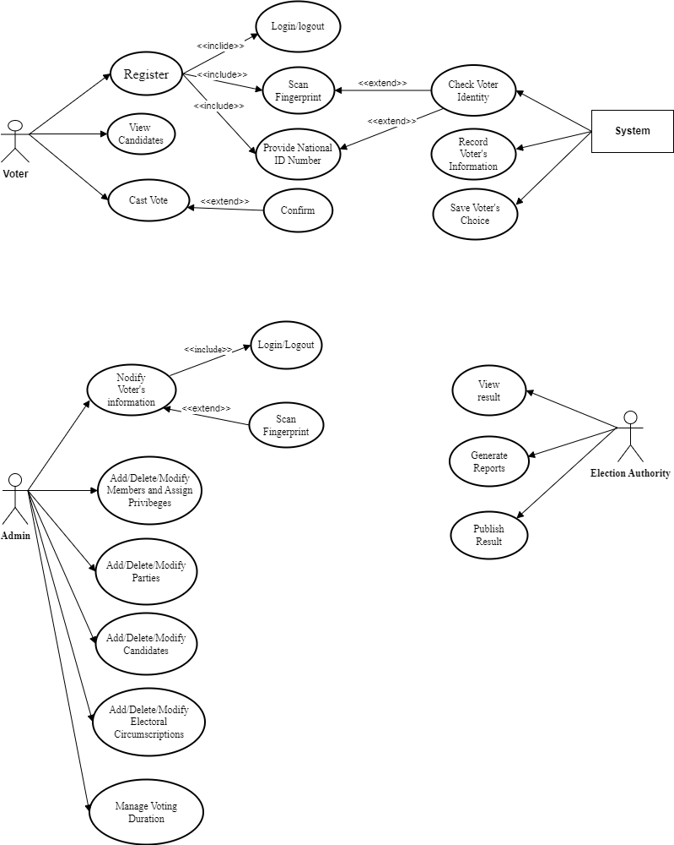
UML DIAGRAM
Online Voting System Web Application in Python
Anna University, Chennai

Slide 20
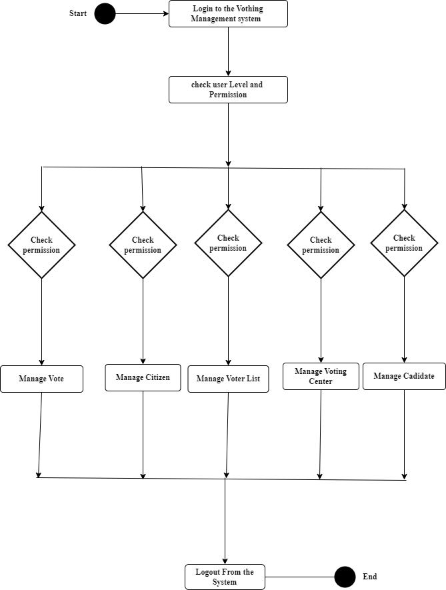
ACTIVITY DIAGRAM
Online Voting System Web Application in Python
Anna University, Chennai

Slide 21
DATABASE DESCRIPTION
Online Voting System Web Application in Python
Table No: 1. Users
S.NO | FILED NAME | DATA TYPE | SIZE | CONSTRAINTS | DESCRIPTION
1 | User_id | Int | 10 | Primary key | Unique identifier for each user
2 | Username | Varchar | 20 | UNIQUE | User's username for login
3 | Password | Varchar | 20 | Not null | Hashed password for authentication
4 | Email | Varchar | 30 | Unique | User's email address
5 | Role | Varchar | 30 | Not null | Role of the user (e.g., voter, admin)
Anna University, Chennai

Slide 22
DATABASE DESCRIPTION
Online Voting System Web Application in Python
Table No: 2. Election
S.NO | FILED NAME | DATA TYPE | SIZE | CONSTRAINTS | DESCRIPTION
1 | Election_id | Int | 10 | Primary key | Unique identifier for each election
2 | Title | Varchar | 20 | Primary key | Title of the election
3 | Description | Text | 30 | Not null | Description of the election
4 | Start_date | Datetime | 10 | Not null | Start date and time of the election
5 | End_date | Datetime | 10 | Not null | End date and time of the election
6 | Status | Varchar | 30 | Not null | Current status of the election
Anna University, Chennai

Slide 23
DATABASE DESCRIPTION
Online Voting System Web Application in Python
Table No: 3. Candidates
S.NO | FILED NAME | DATA TYPE | SIZE | CONSTRAINTS | DESCRIPTION
1 | Candidate_id | Int | 20 | Primary key | Unique identifier for each candidate
2 | Election_id | Int | 30 | Foreign key | Identifier of the associated election
3 | Name | Varchar | 15 | Not null | Name of the candidate
4 | Party | Varchar | 20 | Not null | Party affiliation or independent
5 | Description | Text | 30 | Not null | Description or bio of the candidate
6 | Image_url | Varchar | 30 | Not null | Url to the candidate's image
Anna University, Chennai

Slide 24
DATABASE DESCRIPTION
Online Voting System Web Application in Python
S.NO | FILED NAME | DATA TYPE | SIZE | CONSTRAINTS | DESCRIPTION
1 | Vote_id | Int | 10 | Primary key | Unique identifier for each vote
2 | User_id | Int | 20 | Foreign key | Identifier of the user who cast the vote
3 | Election_id | Int | 20 | Foreign key | Identifier of the associated election
4 | Candidate_id | Int | 30 | Foreign key | Identifier of the candidate voted for
5 | Timestamp | Datetime | 30 | Not null | Timestamp of when the vote was cast
Table No: 4 .Votes
Anna University, Chennai

Slide 25
CONCLUSION
Online Voting System Web Application in Python
The online voting system web application developed using Python frameworks, such as Flask or Django, represents a significant advancement in modern voting technology. By providing a user-friendly interface, the application simplifies the voting process, ensuring that users can easily register, log in, and cast their votes. The robust security measures integrated into the system such as secure user authentication and data encryption safeguard against unauthorized access and ensure the integrity of the voting process. Additionally, the efficient data management capabilities of Python frameworks enable accurate and reliable handling of user information, votes, and election results.
Anna University, Chennai

Slide 26
SCOPE FOR FUTURE ENHANCEMENT
Online Voting System Web Application in Python
Future enhancements for the online voting system web application developed with Python Django can significantly elevate its functionality and user experience. Integrating advanced identity verification mechanisms, such as government issued ID validation, could further fortify security and ensure the authenticity of voter identities. Implementing automated voter registration processes and seamless integration with national or local databases could streamline registration and reduce administrative tasks.
Anna University, Chennai

Slide 27
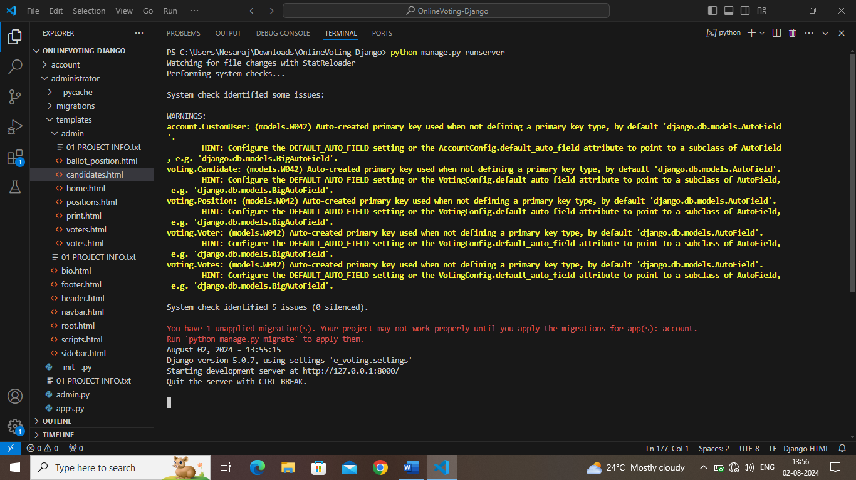
SCREEN SHOTS
Online Voting System Web Application in Python
Anna University, Chennai

Slide 28
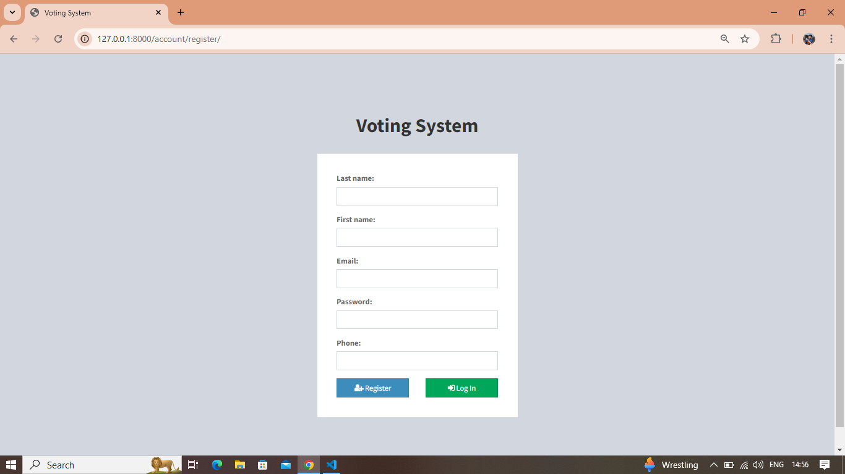
SCREEN SHOTS
Online Voting System Web Application in Python
Anna University, Chennai

Slide 29
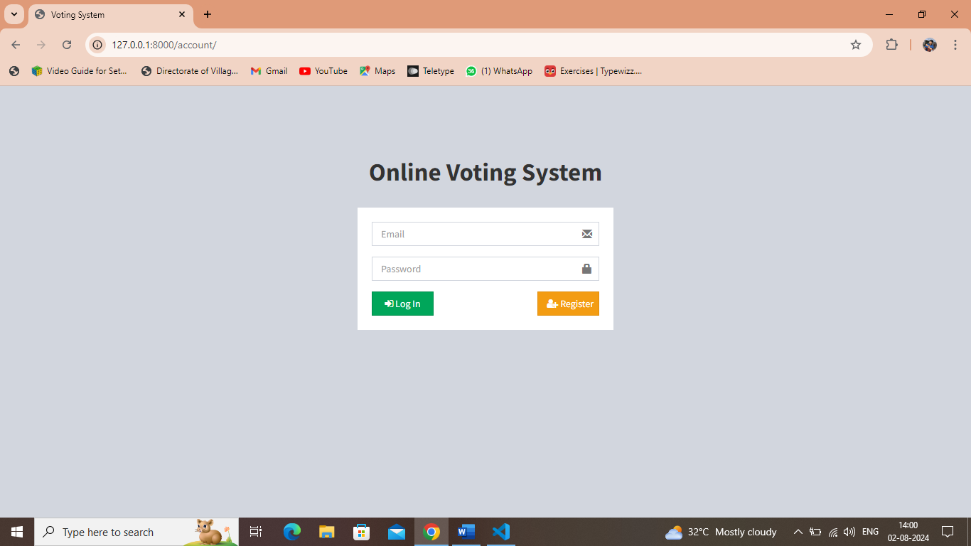
SCREEN SHOTS
Online Voting System Web Application in Python
Anna University, Chennai

Slide 30
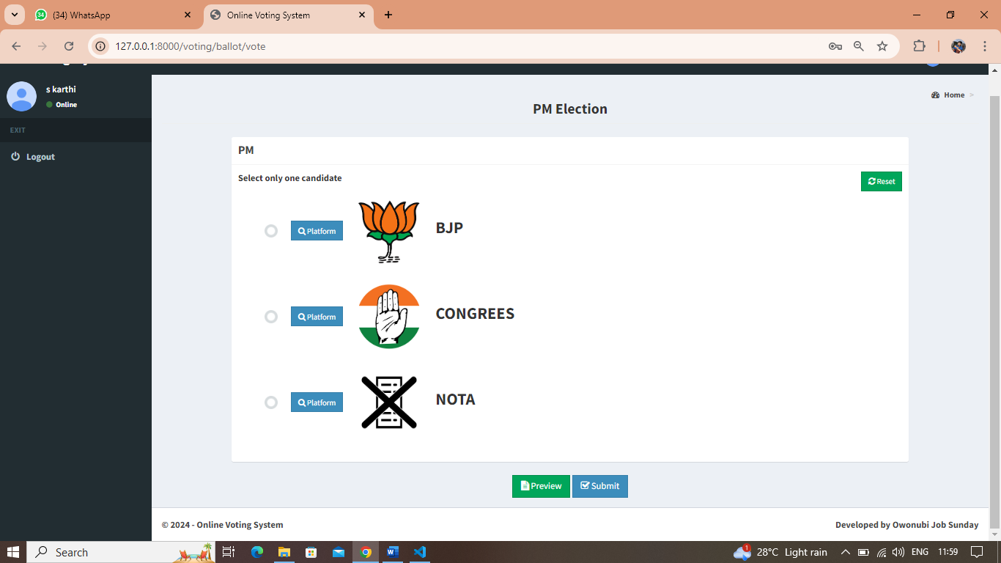
SCREEN SHOTS
Online Voting System Web Application in Python
Anna University, Chennai

Slide 31
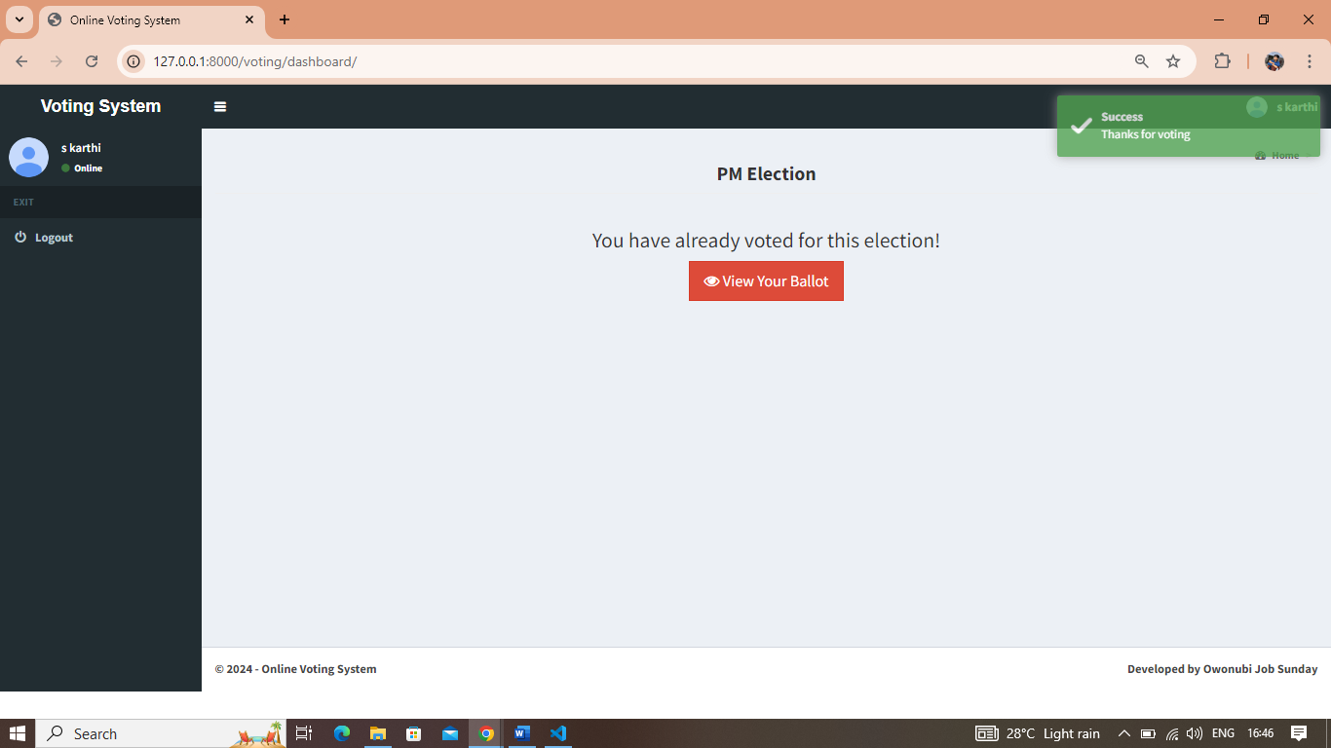
SCREEN SHOTS
Online Voting System Web Application in Python
Anna University, Chennai

Slide 32
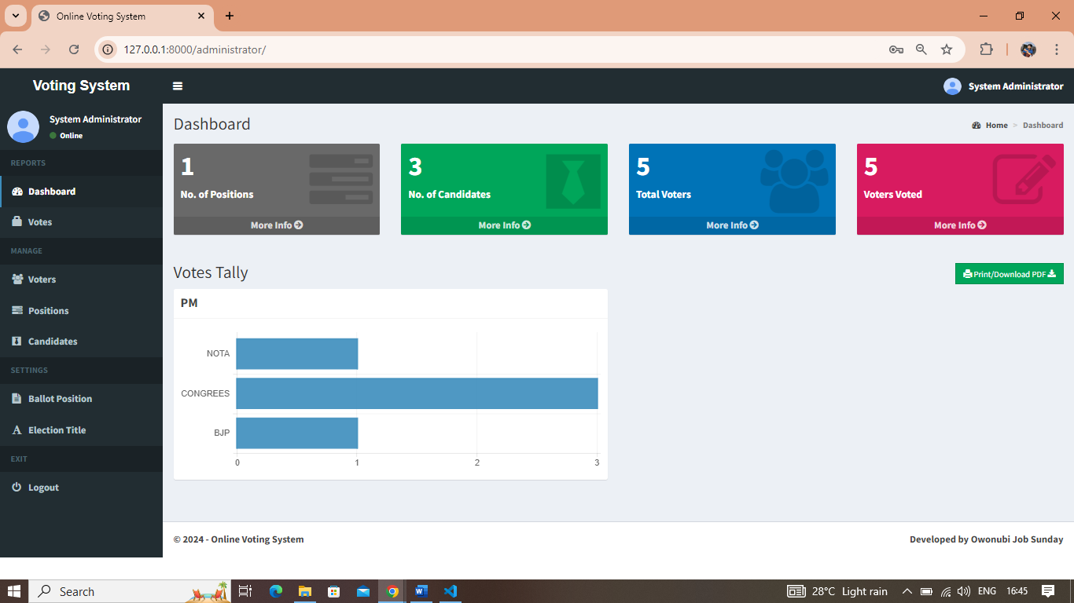
SCREEN SHOTS
Online Voting System Web Application in Python
Anna University, Chennai

Slide 33
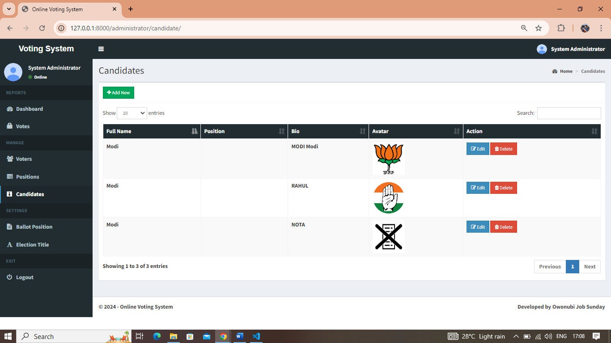
SCREEN SHOTS
Online Voting System Web Application in Python
Anna University, Chennai

Slide 34
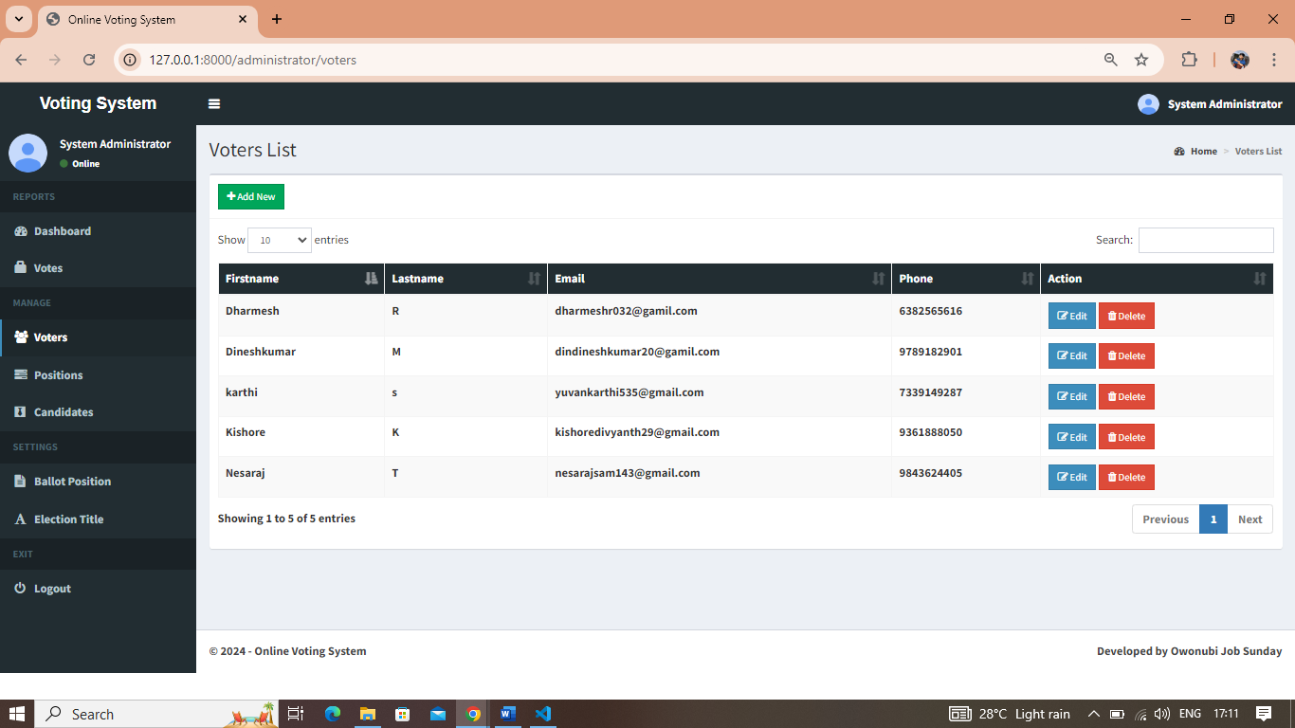
SCREEN SHOTS
Online Voting System Web Application in Python
Anna University, Chennai

Slide 35
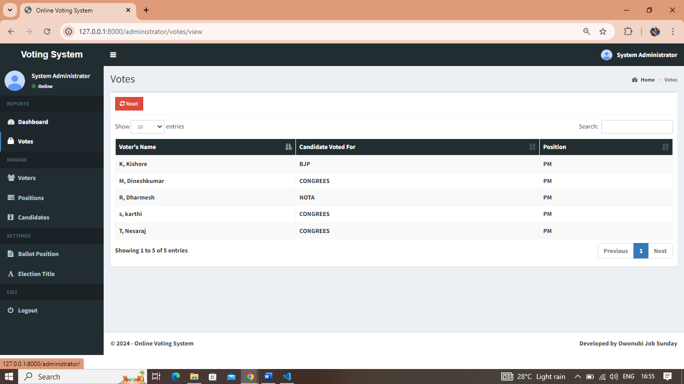
SCREEN SHOTS
Online Voting System Web Application in Python
Anna University, Chennai

Slide 36
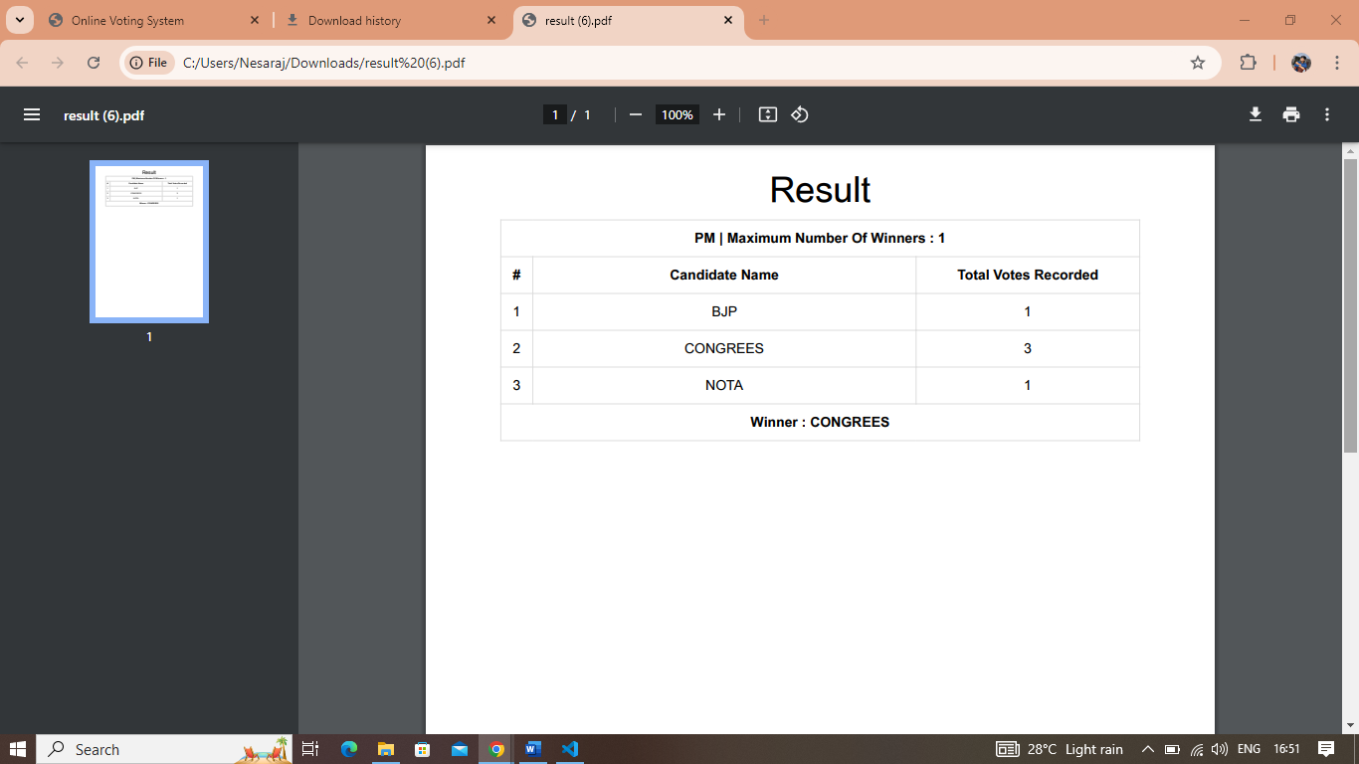
SCREEN SHOTS
Online Voting System Web Application in Python
Anna University, Chennai

Slide 37
Conference Presentation
Name of the College:
Title of the Presentation:
Date:

Slide 38
REFERENCES
Online Voting System Web Application in Python
Web Reference
[1] https://easychair.org/publications/preprint/5xGf
[2] https://www.youtube.com/watch?v=XF74EqOrl-Q
[3] https://www.youtube.com/watch?v=r6q_Q-u05HU
Book Reference
[1] Online Voting: Technology and Business Practice by P. Y. A. Singh Publish Date: 2010 .
[2] Online Voting: An Overview of Existing and Emerging Technologies by R. S. W. S. Wahid and D. B. MacKenzie Publish Date: 2007.
[3] Designing Secure and Resilient Online Voting Systems by Michael W. S. Ng Publish Date: 2021
Anna University, Chennai

